Slide 1

Fake News Detection
Data Science Capstone Project

Slide 2
Hyper: Team Members
Thitthima A/P Wat
Elle Aliz binti Aminuddin
Muhammad Harraz bin Harun

Slide 3


Task 1
Business Understanding

Slide 4
Introduction: Fake News Is…
News that are blatantly false.
Mostly not fully fake but falsely interpreted from real news
Fake facts are added to make the news more interesting
More likely to go viral compared to real news.
Can be found easily on social medias like Facebook, Twitter and WhatsApp.

Slide 5

Objective
To detect either the news is real or fake since sometimes we cannot determine it by ourselves.

Slide 6

Goals
to differentiate fake news from real news

Slide 7

Questions
How can we detect which news is real and which is fake since there is too much news out there?

Slide 8

Measurements
Based on the data, the percentage of accuracy that we get will be the measurement in this project. If the percentage is high means the model is good and vice versa.

Slide 9

Task 2
Data Management

Slide 10
Data Management Plan: Data
Training data from internet about 6000 data
Testing data from web scrapping (Twitter, Facebook, News etc) about 300 data
No sensitive data

Slide 11
Data Management Plan: Variable
Training
3 variables
title, text & label
Testing
5 variables
title, text, subject, date and label
for analysis

Slide 12
Data Management Plan: STEPS
Web Scrapping
Conversion of data from txt file to excel
Data Wrangling
Data storing for short- and long-term memory

Slide 13
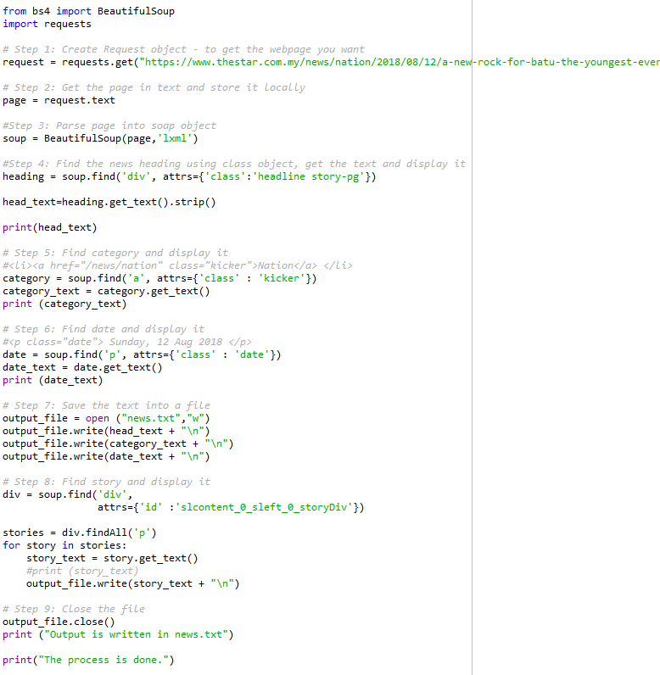
Web Scraping Code

Slide 14
How this plan will facilitate the needed analysis
help us on which step should do first and what should we do.
get a quality data under a short period of time
we just reduce the bias and handle with the missing values in our data for the analysis part
thus, the process of exploratory data analysis will easier since the data is already cleaned

Slide 15
Data Wrangling
Discovery
Structuring
Cleaning
Publishing
Enriching
Validating

Slide 16
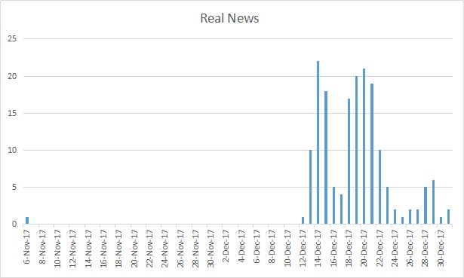
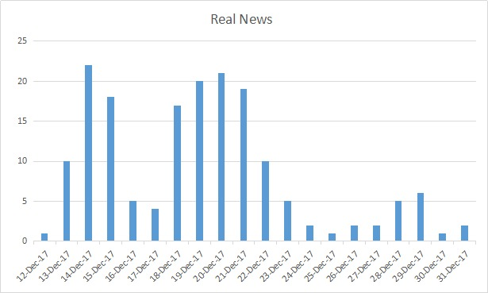
Report findings From Exploratory DATA Analysis
To detect the number of fake news after data wrangling.
There are 2 data (Data from link and Data scraping)
Has 176 datasets and 7 columns.
Before wrangling shows many no value in certain date and the bar chart shows in the middle have no value.
After wrangling, the no value at bar chart before wrangling have been deleted and shows the bias in bar chart before wrangling is more than the bar chart after wangling.

Slide 17
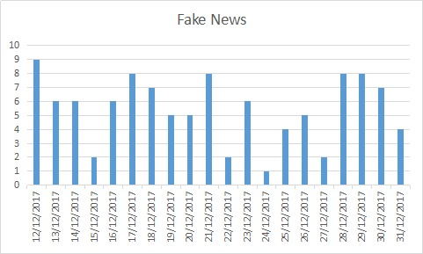
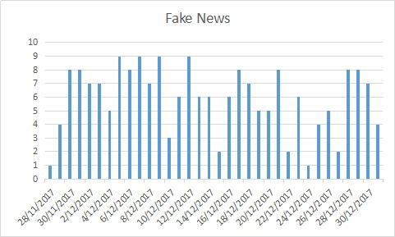
Report findings From Exploratory DATA Analysis
Has 105 datasets and 7 columns.
Before wrangling, the bar chart is compact.
After wrangling, the bar chart shows no compact because the date from 28/11/2017 until 10/12/2017 have been deleted and bias will be decreased compared to bar chart fake news before wrangling.

Slide 18
Data Variables
5 different variables
title, text, subject, date, and label
title & text are used for prediction

Slide 19
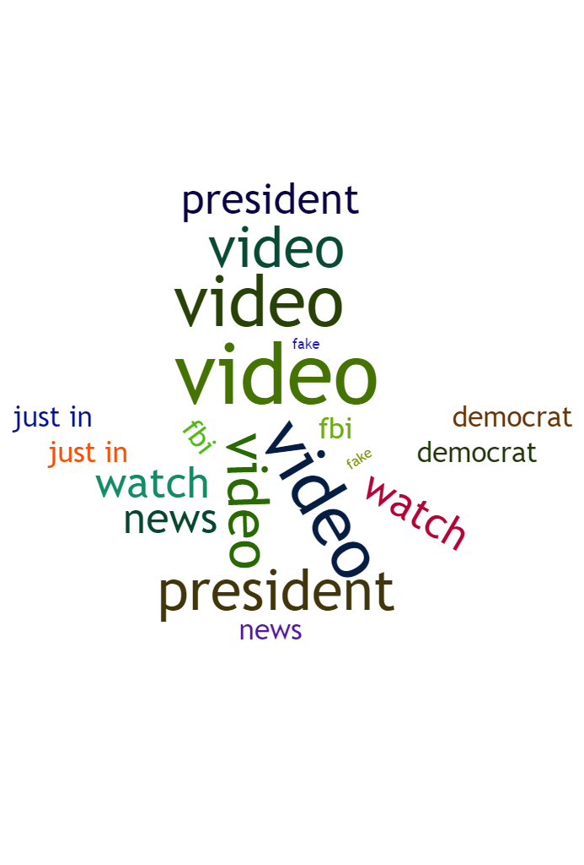
Analysis & Prediction: Word Cloud
Most frequent words for the Fake News Data
The word video is the most frequent word.
Acts as a ‘click bait’.

Slide 20
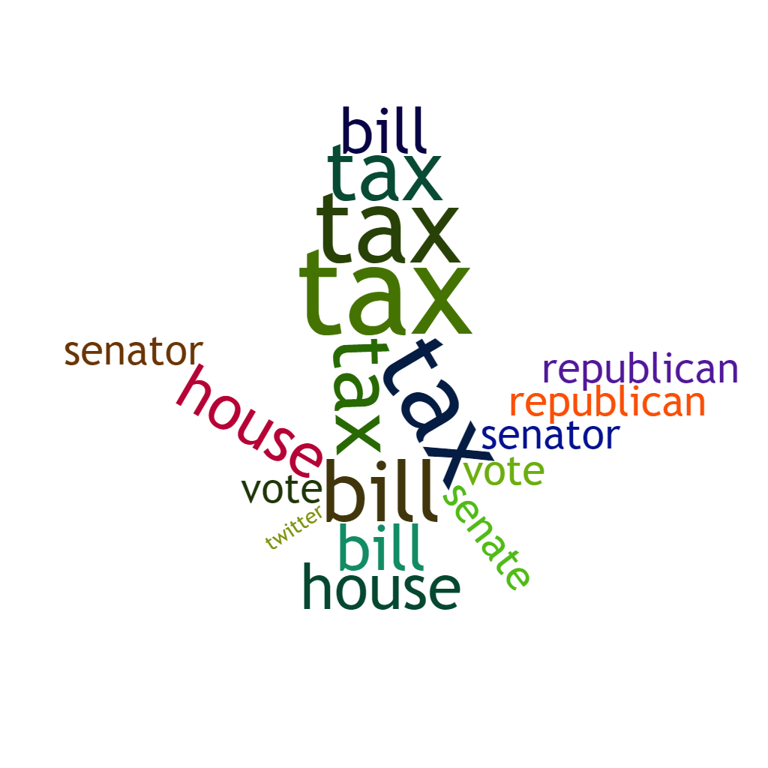
Analysis & Prediction: Word Cloud
Most frequent words for the Real News Data
The words most frequent are considered as high-level words that are more formal

Slide 21
Analysis & Prediction: Pattern
Fake news is more frequent when real news is not
Some fake news are just speculations made for a certain event
Released earlier than the real news which needs further investigation and fact check
This observation can be inaccurate as the data we have might be randomly chosen without taking this into account.

Slide 22

Task 3
Modelling & Evaluation

Slide 23
Algorithms Used
Naïve Bayes Classifier
01
Passive Aggressive Algorithm Classifier
02
Support Vector Machine Classifier
03
Stochastic Gradient Descent Classifier
04

Slide 24
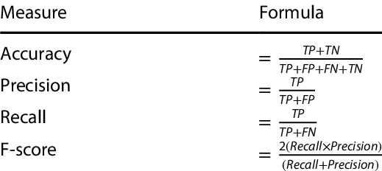
Evaluation Measure

Slide 25
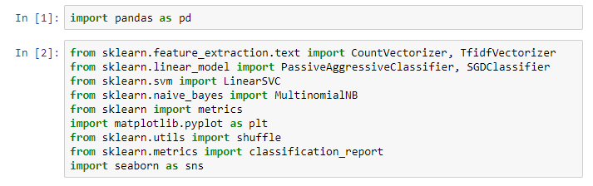
Modelling Preparation
1. Import library

Slide 26
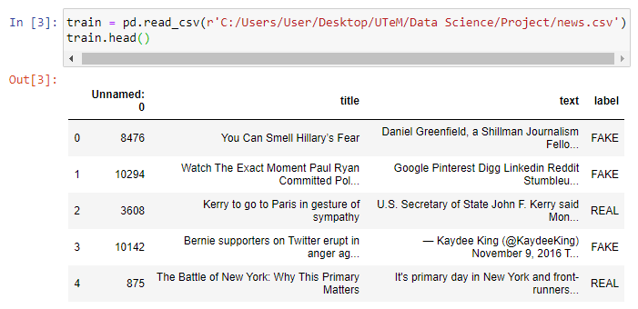
Modelling Preparation
2. Import Training Data Set

Slide 27
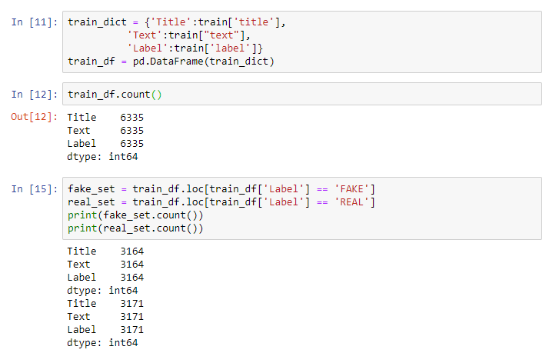
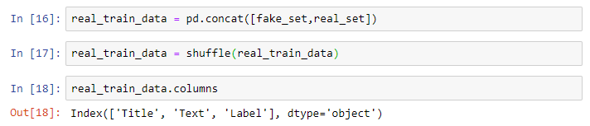
Modelling preparation
3. Change the data into Data Frame and classify only REAL and FAKE

Slide 28
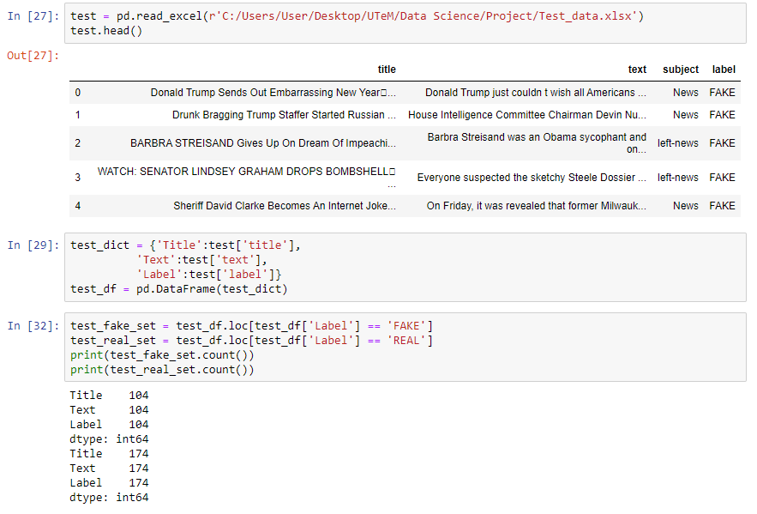
Modelling Preparation
4. Import Training Data Set

Slide 29
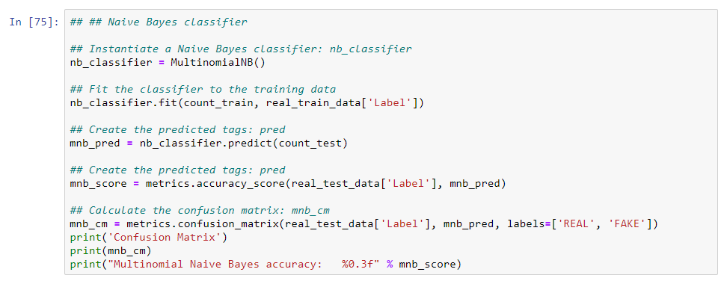
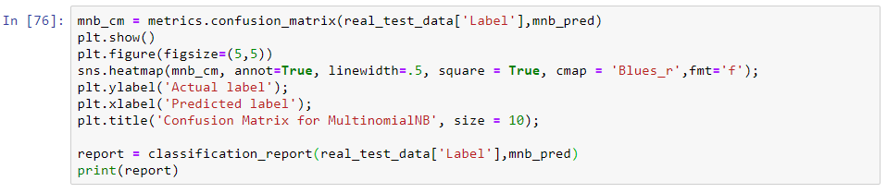
Modelling Implementation: Naïve Bayes Classifier

Slide 30
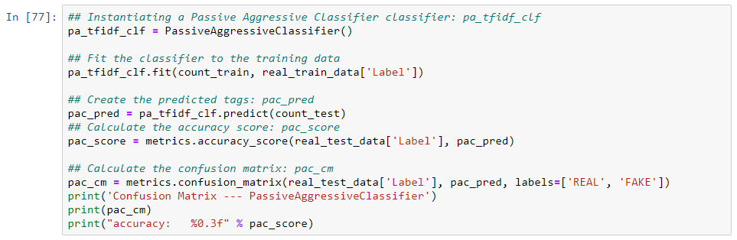
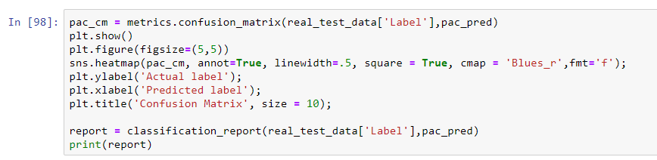
Modelling Implementation: Passive Aggressive Algorithm Classifier

Slide 31
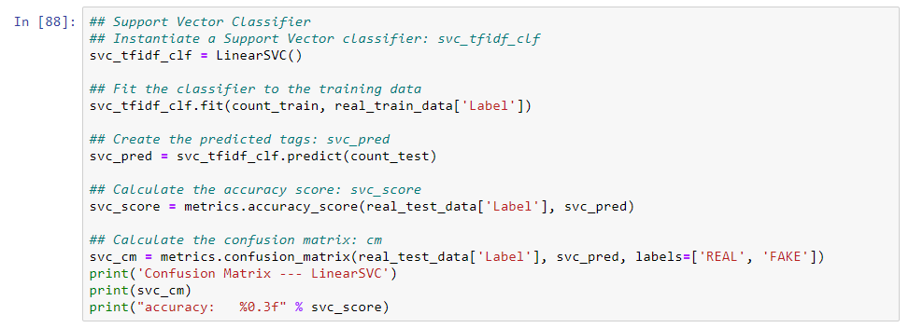
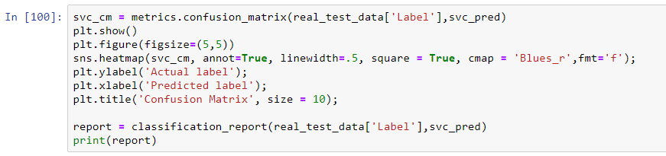
Modelling Implementation: Support Vector Machine Classifier

Slide 32
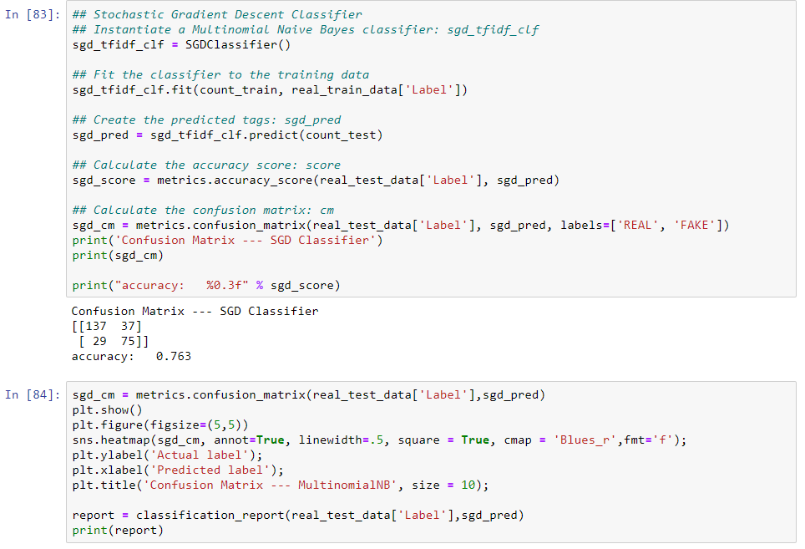
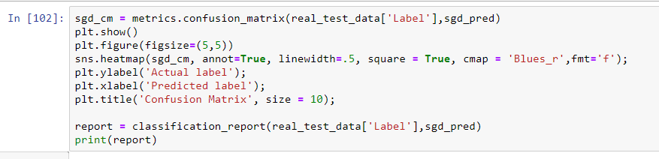
Modelling Implementation: Stochastic Gradient Descent Classifier

Slide 33
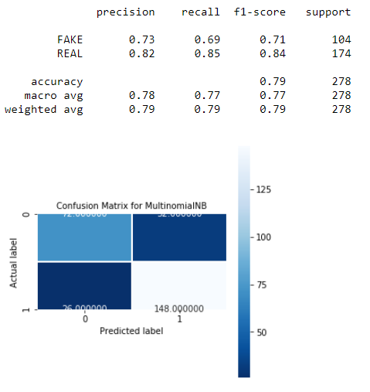

Results: Naïve Bayes Classifier

Slide 34
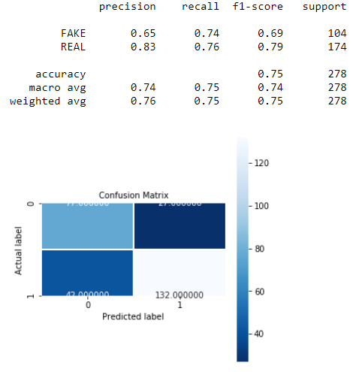

Results: Passive Aggressive Algorithm Classifier

Slide 35
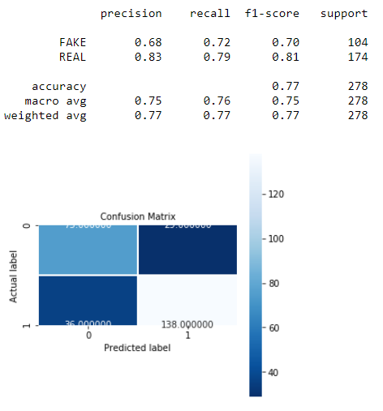

Results: Support Vector Machine Classifier

Slide 36

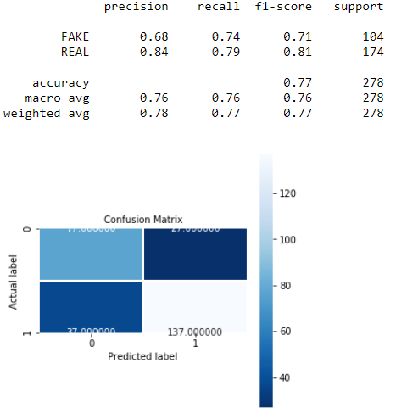
Results: Stochastic Gradient Descent Classifier

Slide 37
Analysis
Classifier | Naive Bayes | Passive Aggressive | SVM | Stochastic Gradient Descent
Accuracy | 0.791 | 0.745 | 0.766 | 0.770
Precision (Macro Avg) | 0.78 | 0.73 | 0.75 | 0.76
Precision (Weighted Avg) | 0.79 | 0.75 | 0.77 | 0.78
Recall (Macro Avg) | 0.77 | 0.73 | 0.76 | 0.77
Recall (Weighted Avg) | 0.79 | 0.74 | 0.77 | 0.77
F1-Score (Macro Avg) | 0.77 | 0.73 | 0.75 | 0.76
F1-Score (Weighted Avg) | 0.79 | 0.75 | 0.77 | 0.77
Best Algorithm: Naïve Bayes Classifier

Slide 38
Conclusion
fake new classifier model is good but not the best
Naive Bayes algorithm is the best amongst all
All the algorithms get the accuracy more than 70%.

